Slide 1
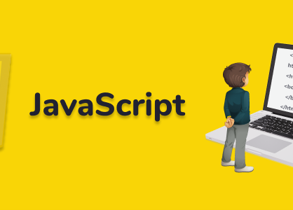
Week 4

Slide 2


Class Announcements (12/4/2023)
Motivation
Git Setup
Review Window Object & Conditionals
Finish Conditionals
Conditional Activity
Arrays (if we have time) Class Link Recordings

Slide 3
Class Activity
Check if the season is Autumn, Winter, Spring or Summer. If the user input is :
September, October or November, the season is Autumn.
December, January or February, the season is Winter.
March, April or May, the season is Spring
June, July or August, the season is Summer

Slide 4
Class Activity
Check if a day is weekend day or a working day. Your script will take day as an input.
What is the day today? Saturday
Saturday is a weekend.
What is the day today? saturDaY
Saturday is a weekend.
What is the day today? Friday
Friday is a working day.
What is the day today? FrIDAy
Friday is a working day.

Slide 5
Class Activity
Write a program which tells the number of days in a month.
Enter a month: January
January has 31 days.
Enter a month: JANUARY
January has 31 day
Enter a month: February
February has 28 days.
Enter a month: FEbruary
February has 28 days.

